Slide 1
Nasdanika HTML
Fluent Java API for building HTML/Bootstrap Web UI
v. 1.3.0
A component of Nasdanika Foundation Server

Slide 2
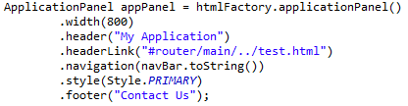
Overview
Fluent Java API to build
Low level – HTML elements
High level:
Bootstrap UI elements
Font Awesome icons
Angular directives
Single-page applications
18 Style themes
Sources: https://github.com/pvlasov/nasdanika/tree/master/org.nasdanika.html

Slide 3
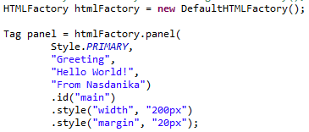
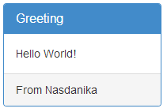
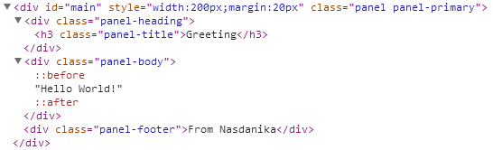
Getting Started
Instantiate org.nasdanika.html.impl.DefaultHTMLFactory
Use the factory to create generation components.
Component’s toString() produces HTML.

Slide 4
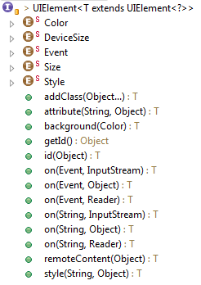

Low-level HTML API
UIElement, Container & Tag interfaces
Set attributes
Recognizes importance of id, style, and class attributes
Shortcut method to set id.
class attribute can be manipulated as a list with addClass() method
style attribute can be manipulated as a map with style(String, Object) method
Fluent API – methods return element and can be chained.
Enumerations for color, device size, element size, and element style
tag(), link(), fragment() and input() factory methods.

Slide 5
High-level Bootstrap API
Accordion
Application panel
Alert
Breadcrumbs
Button
Form
Glyphicons
Input group
Label
Link group
List group
Modal
Navbar
Panel
Popover
Table
Tabs
Tooltip

Slide 6


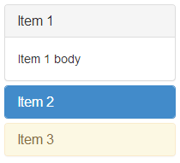
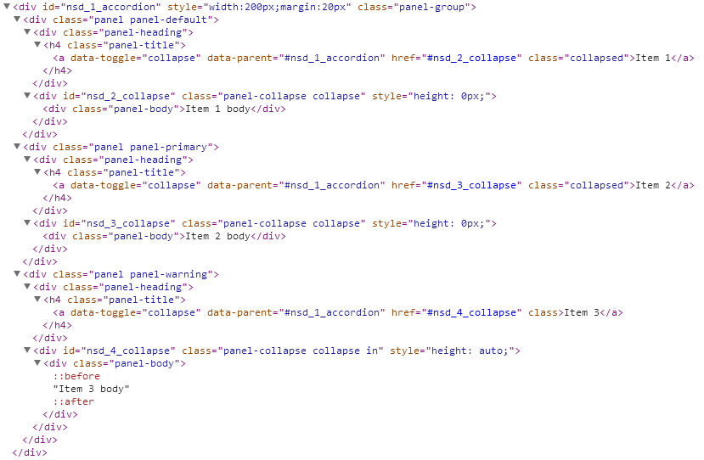
Accordion

Slide 7
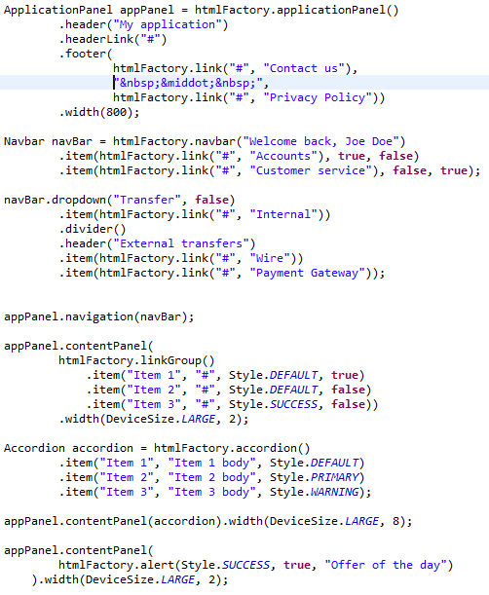
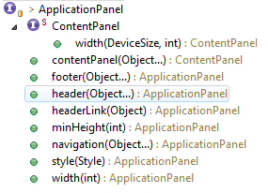
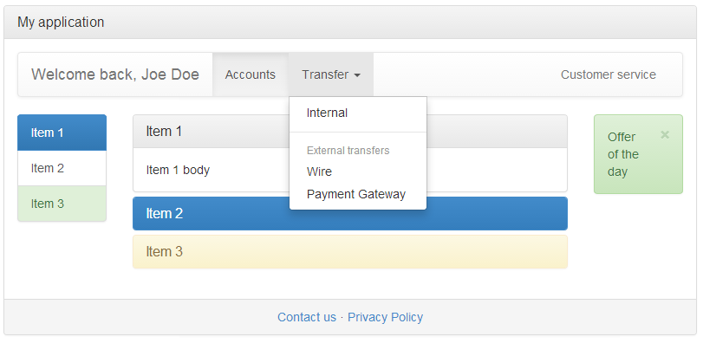
Application Panel
LinkGroup
Alert

Slide 8
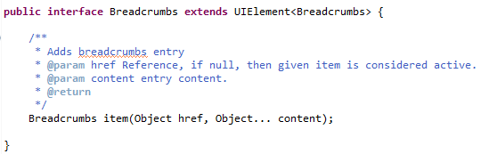

Breadcrumbs

Slide 9

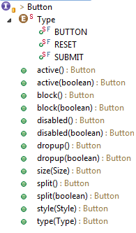
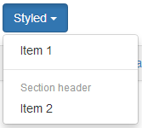

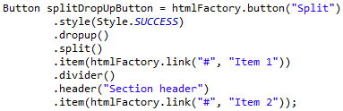
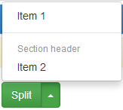


Button

Slide 10
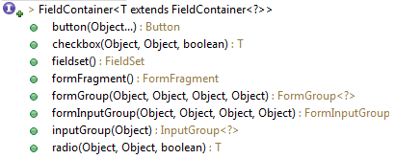
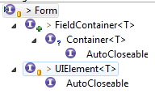

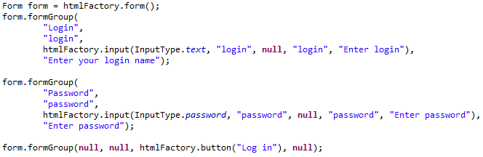
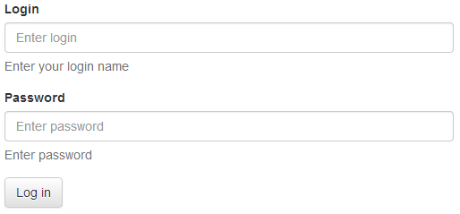
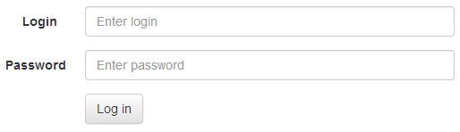

Form
The same form in horizontal layout
And inline layout

Slide 11
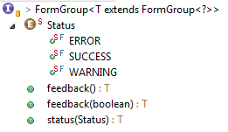
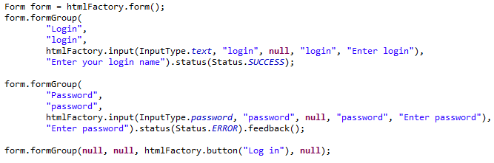
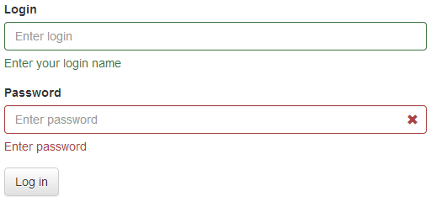
FormGroup

Slide 12
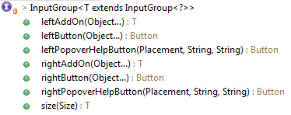

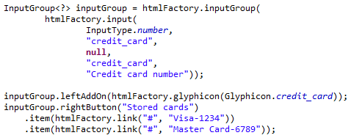
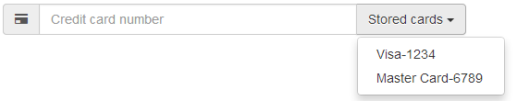
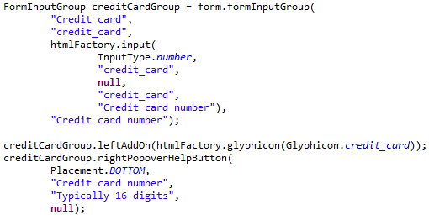
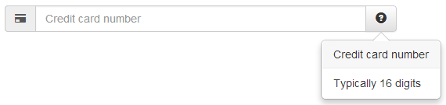
InputGroup
A combination of an input and add-ons
Glyphicon

Slide 13
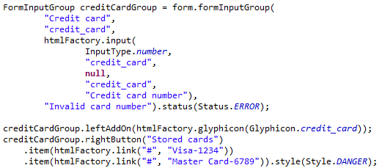

FormInputGroup
A fusion of FormGroup and InputGroup

Slide 14
Label

Slide 15
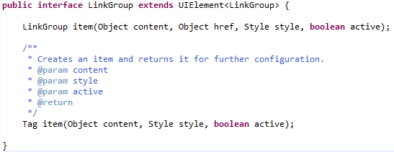


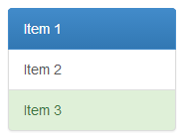
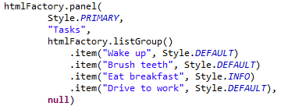
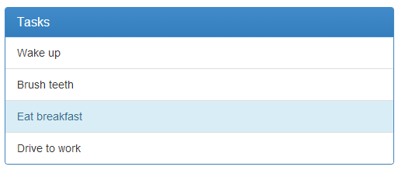
LinkGroup & ListGroup

Slide 16
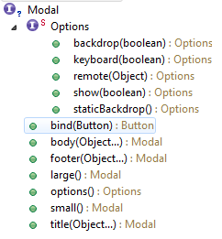
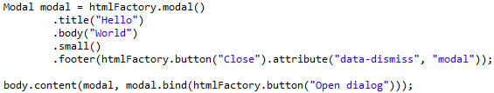
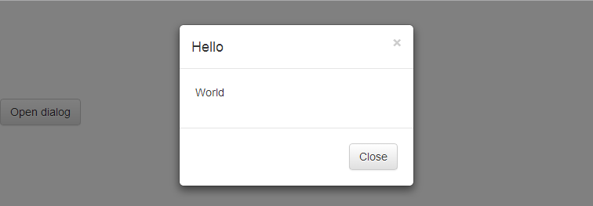
Modal

Slide 17

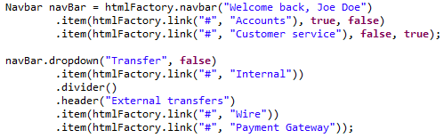
Navbar

Slide 18
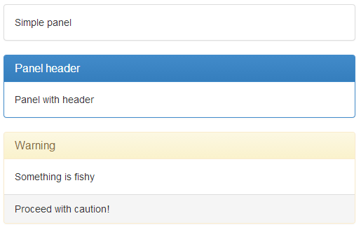
Panel

Slide 19


Popover

Slide 20
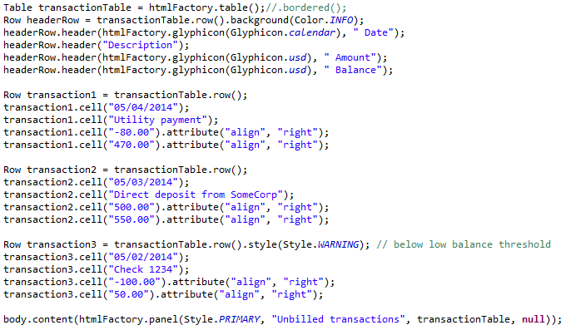
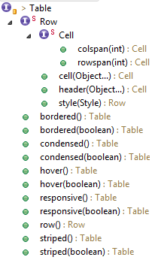
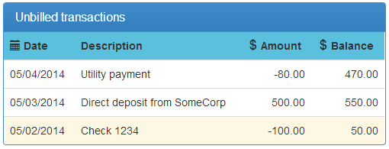
Table

Slide 21
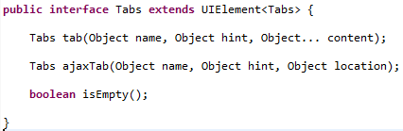

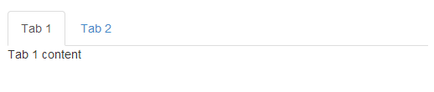
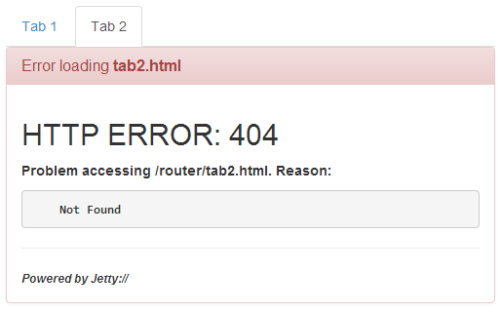
Tabs
Example of error reporting by nsdLoad()

Slide 22
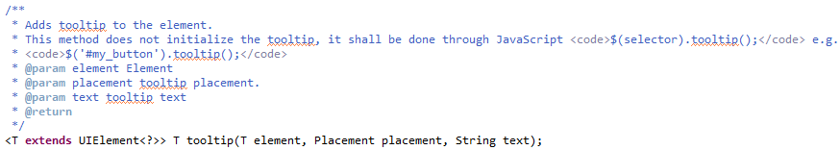


Tooltip

Slide 23
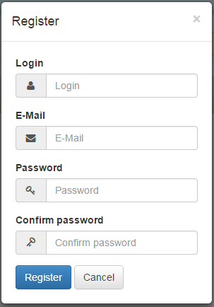
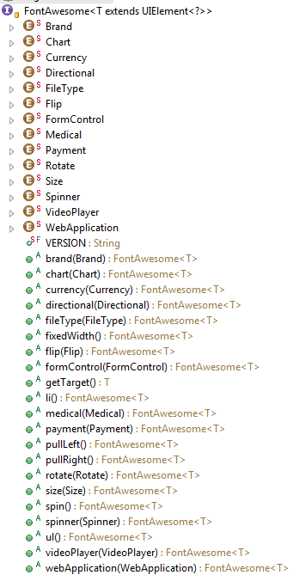
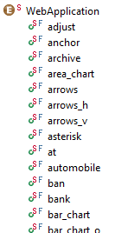
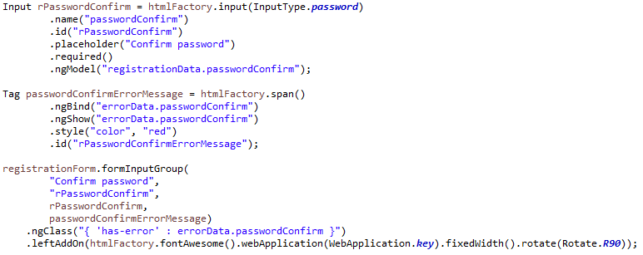
Font Awesome
…

Slide 24
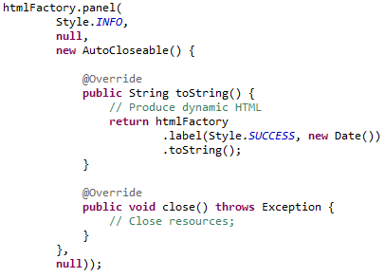
Dynamic content
Content’s toString() is invoked every time component’s toString() is invoked.
Therefore assembled components may be reused and will fetch fresh data every time their toString() is invoked.
AutoCloseable content is closed when component is closed.
Example:
Assemble user UI from preferences and metadata.
Wire dynamic content sources.
Store in user session.
Close UI top component when session closes.
close() will traverse down to AutoCloseable dynamic content and close it.

Slide 25



Router Application
Creates a single-page applications with a Backbone route.
nsdLoad() function – Ajax load with “Loading” indicator and error reporting.
Lists of scripts and stylesheets are provided by the factory.
Ajax loaded from test.html (initial route)

Slide 26


Sample application

Slide 27


Account summary page
Transactions table is dynamically reloaded on transaction period select

Slide 28


Transactions table generation

Slide 29





Themes

Slide 30
References
Wiki - https://github.com/Nasdanika/server/wiki/html
WebTest report – generated with Nasdanika HTML and shows screenshots of the application also generated with Nasdanika HTML – http://www.nasdanika.org/examples/test-report/
Sources - https://github.com/Nasdanika/server/tree/master/org.nasdanika.html
JavaDoc – http://www.nasdanika.org/server/apidocs/org/nasdanika/html/package-summary.html
Bootstrap themes - http://bootswatch.com/
Nasdanika Foundation Server presentation - http://www.slideshare.net/PavelVlasov2/nasdanika-foundation-server

